Slide 1
OOPs Project
JOSAA Counselling
Submitted to:- Dr Santosh Singh Rathore
Done by :
Harsha Vardhan lakavath 2021BCS-31
Mekala Bhavana 2021BCS-41
Narra Abhigna 2021bcs-48

Slide 2
Content
Introduction
Description
Class diagram
Classes and Objects
Independent Functions

Slide 3

Introduction
The Joint Seat Allocation Authority (JoSAA) 2022 has been set up to manage and regulate the joint seat allocation for admissions to 6 institutes for the academic year 2022-23. This includes 2 IITs, 2 NITs, 2 IIITs. Admission to all the academic programs offered by these Institutes will be made through a single platform.

Slide 4
Description
We have created a mini replica of the JOSAA counselling system in which we will be able to :
Apply for JOSAA Counselling
Check opening and closing ranks
Check the Scheduled Events and Business Rules
In our system we have two Rounds of admission process.
We have included reservation for OBC and Physically Handicapped students.
Following is the list of Institutes and branches we have included in our counselling :
IIT Bombay – CSE,ASE(Aerospace Engineering)
IIT Madras – CSE, ME(Mechanical Engineering)
NIT Tirchy – CSE,ECE(Electronics Communication and Engineering)
NIT Surathkal – CSE,AI(Artificial Intelligence)
IIIT Allahabad – IT, IT-BI(Business Informatics)
IIIT Gwalior – CSE, Integrated Mtech IT, Integrated MBA
We have independent functions to display the Scheduled Events and Business Rules
We will display opening and closing ranks for the two Rounds based on the candidates choice.

Slide 5
We stored the details of the student.
Based on the candidates qualification we print the list of Eligible Institutes.
Then we store the candidates top 3 choices.
Now we check whether the candidates rank lies between the opening and closing rank of his preferred choice of Institute and branch for the respective round.
Based on Step 3 and 4 Round 1 seat is allotted to the student.
Candidate has to choose whether he wants to Float/Freeze his seat.
If Freeze is chosen as the option then the seat is allotted and the candidate will not be allowed to participate in the next round.
If Float is chosen then based on Step 3 and 4 Round 2 seat is allotted to the student.
This is the final allotted seat.

Slide 6
Class diagram

Slide 7
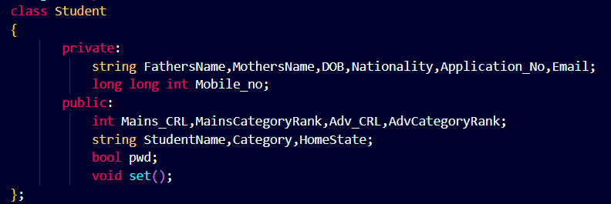
Classes and Objects used
This class contains details of Student
set function is used to store the details of the student.

Slide 8
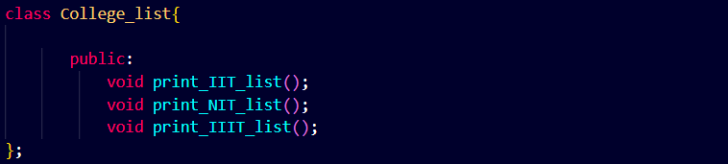
This class gives the list of IITS,NITs and IIITs
print_IIT_list function is used to print the list of IITs available.
Similarly print_NIT_list and print_IIIT_list functions are used to print the list of NITs and IIITs respectively

Slide 9
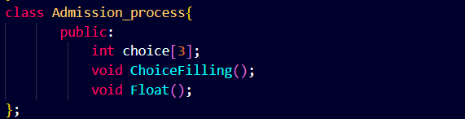
Choice filling for seat allotment is done in this class
ChoiceFilling function is used to store the choices of colleges the student.
float function is used after Round-1 if the student selects float as an option.

Slide 10
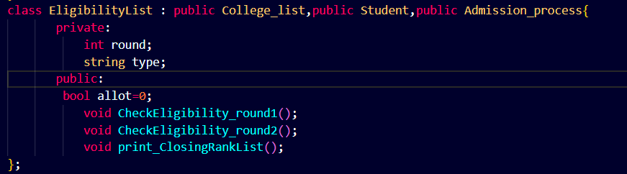
This class is inherited from classes College_list, Student and Admission_process
CheckEligibility_round1 and CheckEligibility_round2 are functions used to allot seat to the student based on the choices filled

Slide 11
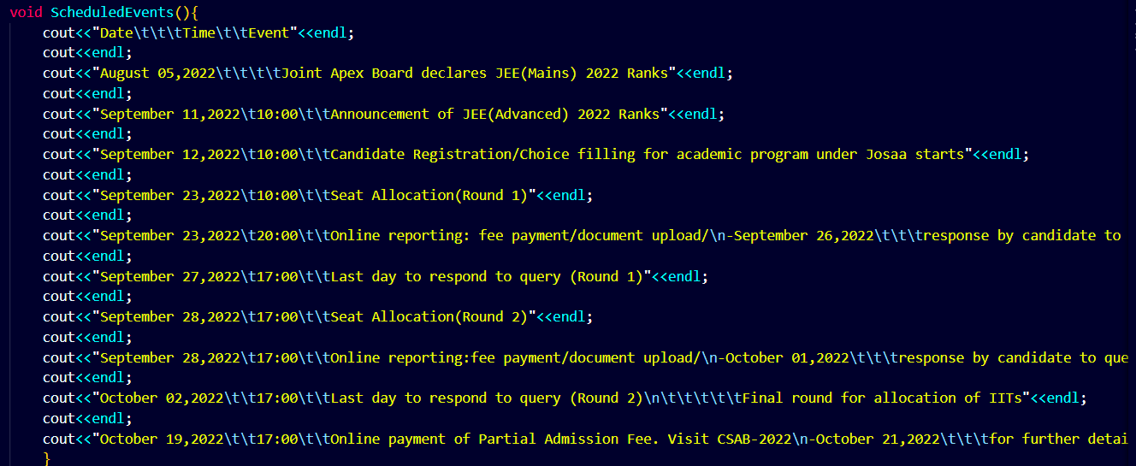
Independent functions used
This function contains the details of events scheduled

Slide 12
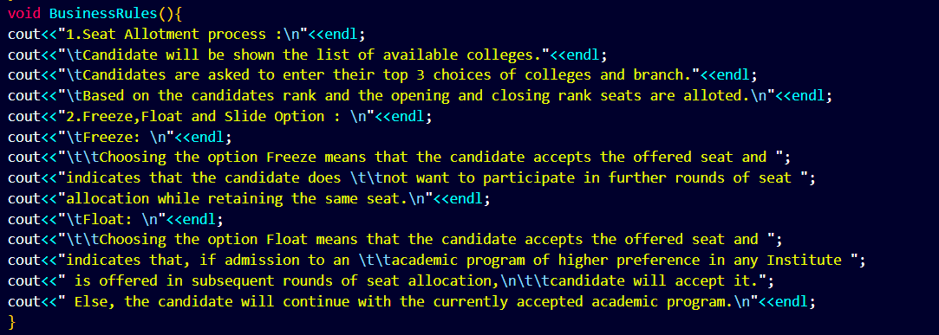
This Function prints the Business rules

Slide 13
Thank You

